Slide 1
Corporate Social Responsibility Report 2025.

Slide 2
Mission, vision, values & commitment

Slide 3




To provide world leading, high-quality data and video technology and services to the rail industry in the UK and internationally.
To provide world leading, first rate electronic and electrical defence engineering products, with full-spectrum integrated logistics support, to our UK and Global Customers.
Our vision is to be the world leading company for intelligent train technology, providing our customers with advanced solutions and dynamic services, helping improve rail safety, enhancing the passenger experience, and saving time and money.
Our vision is to be the world leading company for transformative defence technology, providing the end users of our products with cutting-edge capabilities and our direct customers with advanced support solutions and dynamic services. Our products save lives in combat, contribute to the maintenance of national security, and save time and money in terms of support requirements.

Slide 4
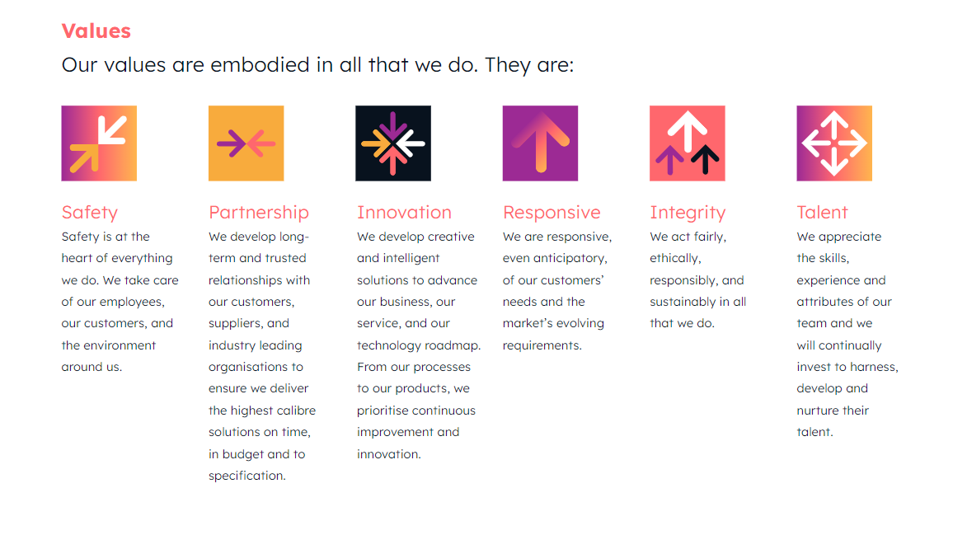
Our Values

Slide 5
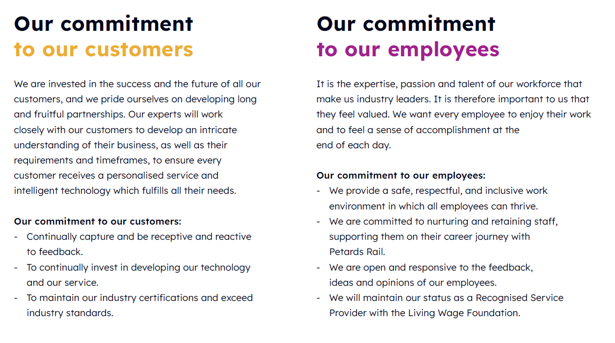
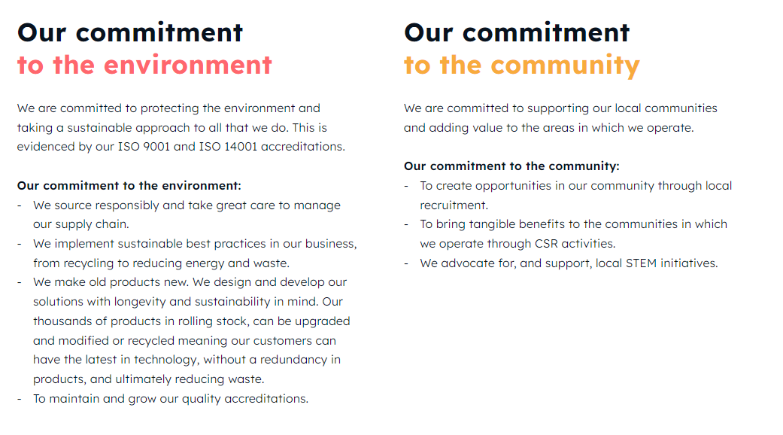
Our Commitments

Slide 6
2025 Summary

Slide 7
ENVIRONMENTAL | Unit | 2021 | 2022 | 2023 | 2024 | 2025 | % Change 24/25
Total Green House Gas Emissions | KGCO2E | 73,289 | 66,316 | 56,315 | 54,612 | 52,263 | 4% | ❑
Energy Consumption - Electricity | KWHR | 254,313 | 213,951 | 200,846 | 185,045 | 170.112 | 8% | ❑
Energy Consumption – Gas | M³ | 12,890 | 12,172 | 8,502 | 9,162 | 9,429 | 3% | ❐
Water Consumption | M³ | 622 | 532 | 542 | 349 | 391 | 11% | ❐
Non-Hazardous Materials Recycled | KG | 7,030 | 7,623 | 9,062 | 8,970 | 7,838 | 17% | ❑
Hazardous Materials used | KG | 490 | 223 | 142 | 153 | 134 | 13% | ❑
PEOPLE
Employees | FTE | 53 | 53 | 46 | 48 | 48 | 0% | NA
Female Employees | % | 17% | 20% | 14% | 9% | 10 | 1% | ❑
Number of Lost time Incidents | Incidents | 0 | 0 | 1 | 0 | 0 | 0 | ❑
% of workers above living wage | % | NM | 100 | 100 | 100 | Nil | Nil | ◆
ETHICS & GOVERNANCE
Cases of Corruption | Incidents | 0 | 0 | 0 | 0 | 0 | Nil | ◆
Cases of Anti-Competitive Behaviour | Incidents | 0 | 0 | 0 | 0 | 0 | Nil | ◆
Cases of Data Protection Breach | Incidents | 0 | 0 | 0 | 0 | 0 | Nil | ◆
Cases of Modern Slavery | Incidents | NM | 0 | 0 | 0 | 0 | Nil | ◆
Significant Environmental Incidents | Incidents | 0 | 0 | 0 | 0 | 0 | Nil | ◆
KPI Performance Summary – 2021 to 2025

Slide 8





 | Unit | 2021 | 2022 | 2023 | 2024 | 2025 | % Change
Total Green House Gas Emissions | KGCO2E | 73,028 | 66,068 | 56,315 | 54,612 | 52,263 | -4%
Energy Consumption - Electricity | KWHR | 254,313 | 213,951 | 200,846 | 185,045 | 170,112 | -8%
Energy Consumption – Gas | M³ | 12,890 | 12,172 | 8,502 | 9,162 | 9,429 | +3%
Water Consumption | M³ | 622 | 532 | 542 | 349 | 391 | +11%
Petards is ISO 14001:2015 certified and operates within an Integrated Management System framework to effectively manage risks, set targets, monitor performance, and drive continuous improvement.
The company addresses key environmental issues such as energy consumption, greenhouse gas emissions, water management, waste reductions and regulatory compliance. Petards strategy focuses on minimising the environmental impact across processes. This includes significant investments in energy-efficient facilities and processes. As a result of these initiatives, Petards has achieved a 4% reduction in Scope 1 and Scope 2 GHG emissions in 2025 compared to 2024 and a 28% reduction from 2021 levels.
Water consumption increased in 2025 due to unforeseen leaks which have been addressed and included in our mainternance schedule.
Environmental Annual Comparison

Slide 9








Certifications and Memberships.
ISO:9001 | Cyber Essential Plus accredited
ISO:14001 | Living Wage Foundation Accredited Employer
ISO:45001 | Employee Assistance Programme established
ISO:27001
ECOVADIS Platinum

Slide 10
PJL Sustainability Strategies

Slide 11
Sustainability Strategy
Focus
Petards focus is on creating sustainable value for our shareholders, customers, employees, suppliers, partners, stakeholders and local communities.
Review
We regularly review, assess and address the most significant environmental, social and governance impacts of our business activities and the issues that affect our ability to create sustainable value.
Assess Risk
We determine our most significant aspects through risk assessments, PESTLE, SWOT analysis and interested parties’ review.
Assess
Impact
Petards conduct an annual assessment to identify our most significant economic, environmental and social impacts.

Slide 12
Stakeholder Impact Assessment
 | Customers | Employees | Suppliers | Community | Regulators | Shareholders
Engagement | Customer relationships Contracts Website Marketing materials Customer surveys | Town Halls Surveys 1-2-1 meetings Performance reviews Training & development Internal communications | Request for quotations Purchase agreements Supplier code of conduct EHS policies Audits and assessments Email, phone calls, meetings | Community programmes Community open days Local press Local groups | Licences and permits Legal registers Visits and audits | Meetings Reporting Emails Phone calls
Concerns & expectations | On time delivery Product reliability Quick responses Regulatory compliance Corporate responsibility | Open communications Personal development & career growth Competitive pay and benefits Job security Safe and ethical environment | Respectful partnerships Clear communication Clarity of specifications On time payment Ethical conduct | Corporate and social responsibility Management of EHS risks and impacts Support community groups Our charities | Compliance with requirements Environmental responsibility Job creation Financial integrity Ethical conduct | Good governance Sustainable growth Reasonable returns Good reputation
How we deliver expectations | Investment & Innovation Integrated Management Systems Competitive pricing Customer service KPI Certified management systems Regulatory compliance | Promoting mutual trust Promoting diversity Investing in people development Regulatory compliance Performance management | Meeting contractual obligations Purchase orders Responsible business practices Building trust Performance management | Community engagement EHS compliance Support charitable causes Local employer Use local suppliers | Policies to ensure compliance Staying updated on regulatory updates Internal and compliance audits Legal registers On time reporting | Robust risk management Strategies to create value and growth Sustainable reporting ESG ratings

Slide 13
We are committed to advancing the UN Sustainable Development Goals (SDG) and have aligned our sustainability strategy to the most relevant SDG targets and indicators.

Slide 14
Environmental Strategies
 | Area | How it affect Petards | Strategies for 2026
 | Water Usage | Petards consider water a precious resource that must be managed responsibly. Water use is primary for sanitation and hygiene purposes. | Continue to track water usage to determine effectivity of 2025 maintenance activities. Promote efficient usage.
 | Energy Efficiencies | Most of Petards energy consumption is from electricity usage in our facility. In addition, our operations also uses fuel, mainly natural gas to heat the facility. | Petards are focussed on a dual strategy to reduce our energy: Utilising energy efficient equipment and technology Investigating feasibility of renewable energy sources

Slide 15
Environmental Management
As part of our environmental management system, we have measures to segregate, store, and dispose of waste safely and in compliance to regulatory and legislative requirements.
Non-hazardous waste is disposed of either through landfill or recycle programs.
Non hazardous waste 17% reduction in 2025 from 2024 levels.
Petards main non-hazardous waste streams are:
Refuse (General Waste) goes to landfill
WEEE (small electronics and batteries) recycled back into use
Packaging (Paper and Cardboard) recycled back into use
Metal
Hazardous waste 13% decrease in 2025 from 2024 levels.
PJL dispose of hazardous waste in strict compliance with local regulations. Our Hazardous waste streams are
Solvents
Glues
Lithium Batteries
PJL have a target to ensure all personnel responsible for chemical waste and spill management conduct an annual spill response training course

Slide 16


Talent Management, Health & Safety, Human Rights
Petards human resources policies focus on creating an inclusive, empowering, and enabling workplace where employees can thrive. We promote diversity, equality, and mutual trust and respect at the workplace, while the safety, health, and mental wellbeing of our people remain our top priorities. We provide ongoing learning opportunities to our employees for personal and professional development.
Diversity
Petards is an equal opportunity employer. We work with individuals and business partners from various backgrounds and cultures, offering diverse skills, and we strive to create an inclusive work environment regardless of age, religion, race, mental or physical disability, gender identity, marital status, or sexual orientation. Our HR policies are designed to foster an inclusive culture while advocating for fair and progressive workplace practices. As of the end 2025, women represented 10% of our employees and held 20% of our senior managerial positions (General Manager).

Slide 17


Talent Management, Health & Safety, Human Rights Strategies
 | Area | How it affect Petards | 2026 Strategies.
 | Employee Engagement | Highly involved and motivated team members play a crucial role in driving innovation, productivity and performance. Petards engage out employees in various ways to build mutual trust and teamwork. | S.P.I.R.I.T award. Monthly nomination by peers of employees who embody the PJL S.P.I.R.I.T culture. Town hall every 2 months to communicate key business activities and performance.
 | Talent development | Our people are at the heart of our business success. We aim to attract and retain the best talent to maintain our high performance, and our goal is to be an employer of choice. | We will continue to develop and mentor apprentices. We will continue to identify training, and development needs to match people’s aspirations with the needs of the business.
 | Health & Safety | Occupational Health and Safety Our people’s safety, health and wellbeing are our foremost priorities, and we strive to maintain a zero-accident workplace. | We will review our H&S metrics in line with current good practice and implement changes where appropriate Petards work within the framework of a H&S Management system and will continue to work within the framework of ISO 45001.

Slide 18

Local Community Strategies
 | Area | How it affect Petards | 2026 Strategies
 | Local community support | Petards is committed to supporting our local communities and adding value to the areas in which we operate. | We will continue to develop and mentor apprentices. We will continue with Corporate Social Responsibility forum run by staff to support local charities and organisations in the local area, including supporting 2026 charity of choice.

Slide 19


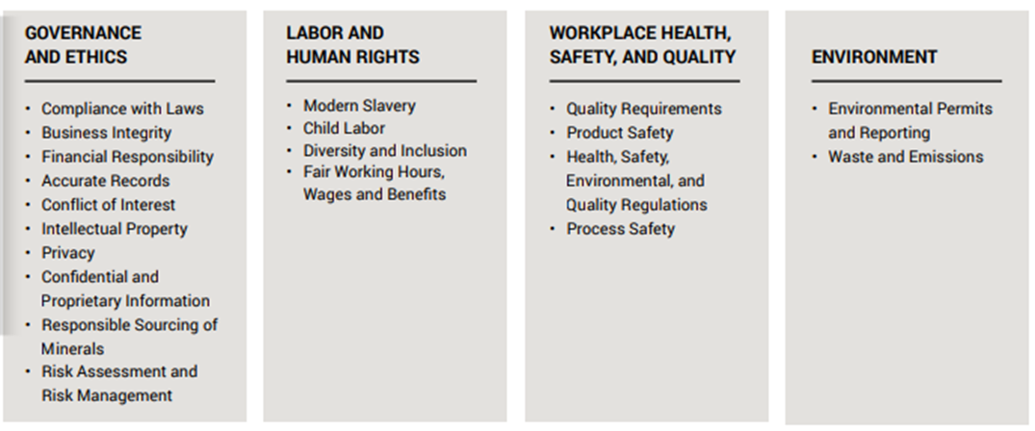
Procurement Strategies
 | Area | How it affect Petards | 2026 Strategies
 | Anti - Competitive behaviour | Petards support free and fair competition among businesses. Our policies require employees to comply with all anti-trust and competition laws. | We will continue to hold our supply chain against Supplier Code of Conduct setting out the minimum standards expected for Governance & Ethics, Labour & Human Rights, Workplace HSE and Environment. We will continue to monitor the Supply Chain KPIs to identify areas of concern. We will continue to undertake Supplier audits.

Slide 20

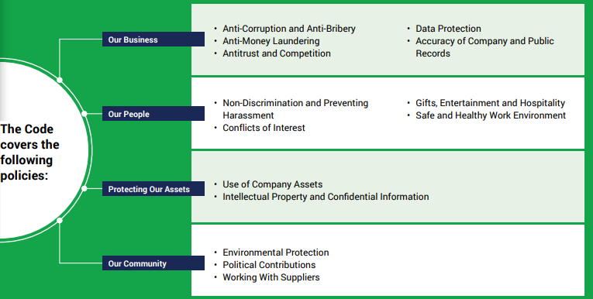
Governance
Petards Employee Handbook and Code of Conduct.
Petards business principles and ethical guidelines are embedded in our Integrated Business Management System.
This is further underpinned by the employee handbook and our code of conduct which details the expected ethical conduct by all employees.
It is communicated to our employees and requires strict adherence. We also extend our ethics and governance principles to our supplier through a supplier Code of Conduct
Anti-Corruption.
Petards maintain a zero policy against corruption, bribery and fraud. Our internal Policies requires full compliance with all anti-bribery and corruption laws in all markets Petards operate in. During the period of 2025 there were no incidents of corruption reported.
Anti-Competitive Behaviour
Petards support free and fair competition among businesses. Our policies require employees to comply with all anti-trust and competition laws.
During the period of 2025 no legal action against Petards was taken for anti-competitive or anti-trust behaviour.

Slide 21
Governance Strategies
 | Area | How it affect Petards | 2026 Strategies
 | Anti Corruption | Petards maintain a zero policy against corruption, bribery and fraud. Our internal Policies require full compliance with all anti-bribery and corruption laws in all markets Petards operate in. | Employees will sign annually to confirm they understand the company’s anti bribery policy.
 | Information Security | As a List X site Petards are committed to deploying the required levels of physical and cyber security to maintain accreditation. Petards are committed to protecting the personal data of our employees, customers and others who may share personal data. | Petards are committed to maintaining information security measures in line with the ISO 27001 Information security Management system We will strengthen our Information Security protection through 3rd party partnerships and collaboration.

Slide 22
Awards and Recognition
Made in the North East Sustainable / Ethical Manufacturer award.
Alstom SME Climate Change Impact award.

